Slide 1

Smart Agriculture
KISHORE DS
19BCE1460
DHAYA SAGAR K
19BCE1726

Slide 2



Agenda
Review 1
Introduction with problem statement and
abstract
Review 2
Complete working model
Review 3
Final project with documentation

Slide 3




Abstract
We have come with a project that is one of the key need of an developing country like India, Smart Agriculture. Our project would enable the end user(The Farmer) to make use of the technology to manage his crop land. Unlike the tier 1 countries there are several different problems faced by the farmers of India. One of the main problems is lack of consideration of minute key natural factors like temperature, humidity, air purity, Ph, animal trespassing etc., which have a very crucial role in crop growth. So, our project would concentrate on these minute key factors to bring up a smarter agriculture.

Slide 4

Problem Statement
Our project helps the farmer manage the maintenance of crops by means of occasional irrigation whenever there is a need through the sensor readings of various sensors like temperature, humidity and also closely monitor trespassing of wild animals into the field.

Slide 5



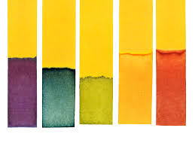
Irrigation Modules
Temperature
Humidity
Or
Moisture
Sunlight
Ph

Slide 6



Animal Trespassing Modules
Detection
Alarm
Alert

Slide 7

Hardware Modules
Ph Sensor
Photo Resistor
Temperature Sensor
Soil moisture Sensor
Gas Sensor
Ultrasonic Sensor
Alarm/Buzzer

Slide 8

Software Modules
Tinker Cad
Node Red

Slide 9


Thank You
KISHORE DS
19BCE1460
DHAYA SAGAR K
19BCE1726

